Slide 1
Airbnb DBT Project
By: Adrian Chavez-Loya

Slide 2
Source data: Comes from official Airbnb open-source data: https://insideairbnb.com/get-the-data/ The historical data we used is for listing and host details from Berlin from the years 2015-2021. This data was stored in AWS.

Slide 3
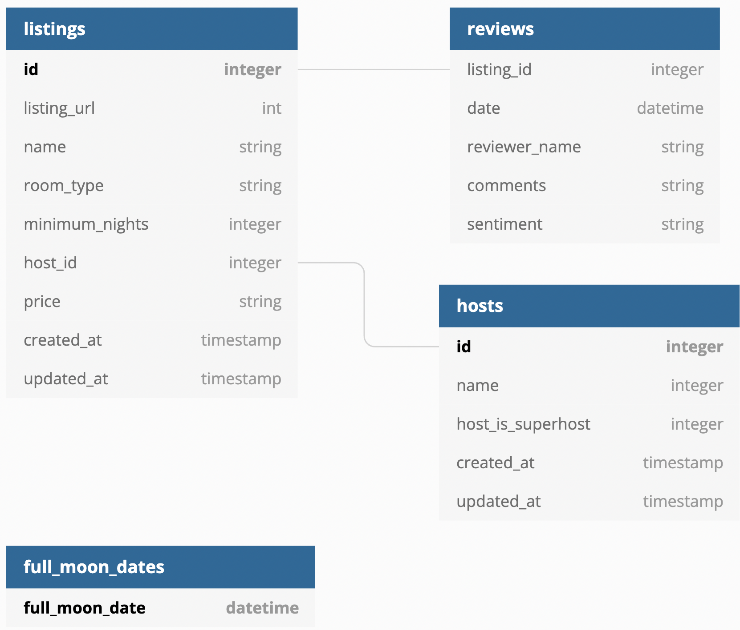
Input source data we took from AWS S3

Slide 4
Our Data Stream in Snowflake we will implement
Raw layer
Staging Layer
Core Layer
raw_listings
src_listings
basic checks
dim_listings_cleansed
cleansing
dim_listings_with_hosts
final dimension table
raw_hosts
src_hosts
basic checks
dim_hosts_cleansed
cleansing
raw_reviews
src_reviews
basic checks
fct_reviews
incremental

Slide 5
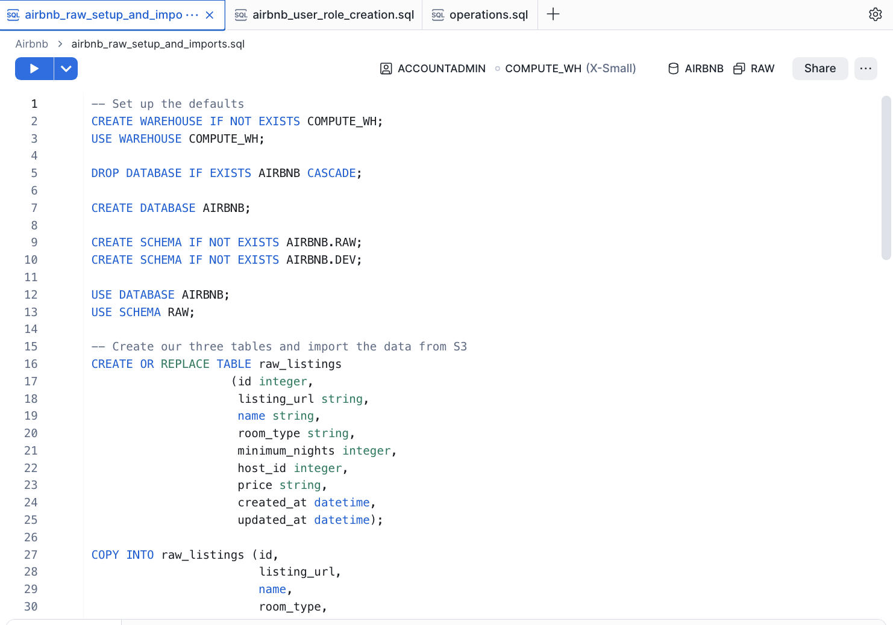
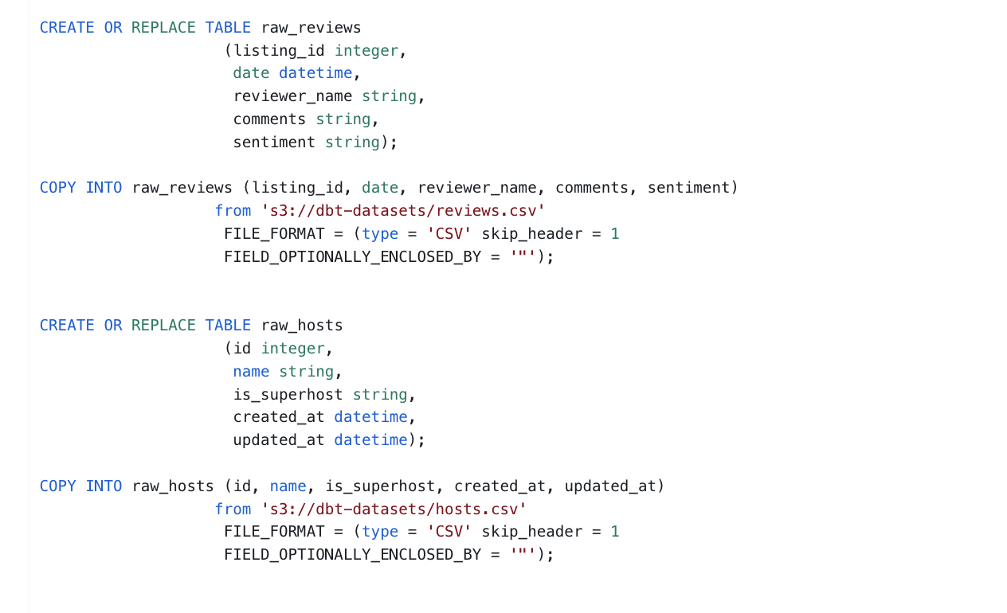
DB/Schema Creation

Slide 6
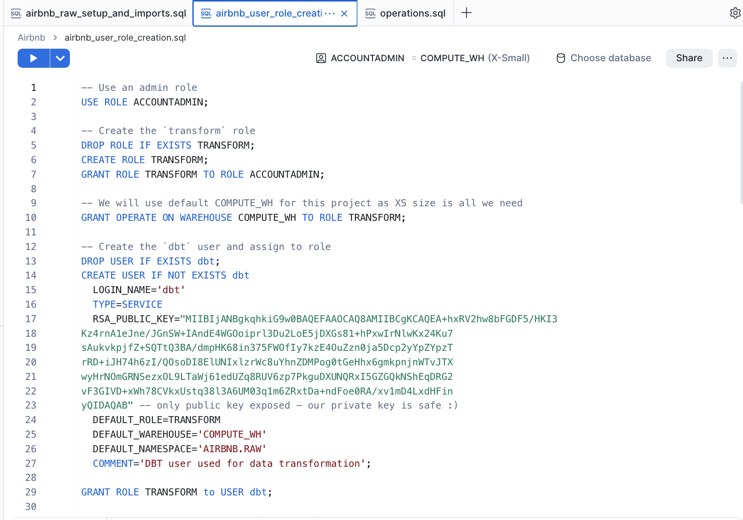
Created roles/warehouse, and dbt access user (private key is safe don’t worry)

Slide 7
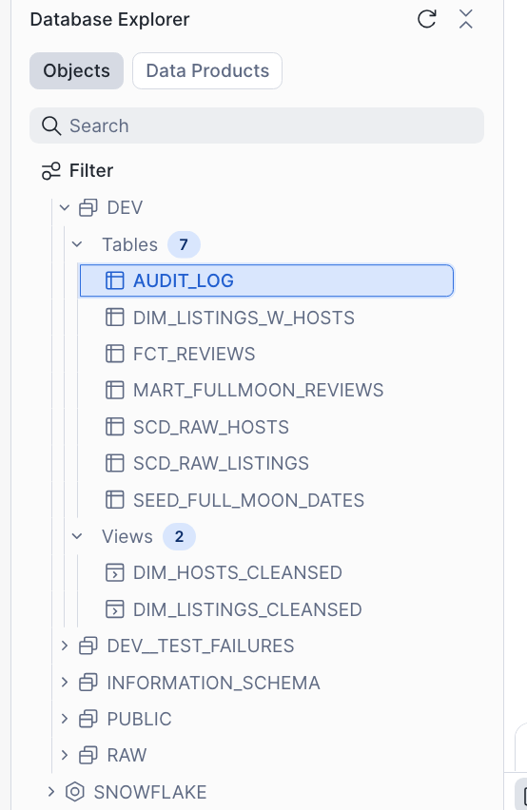
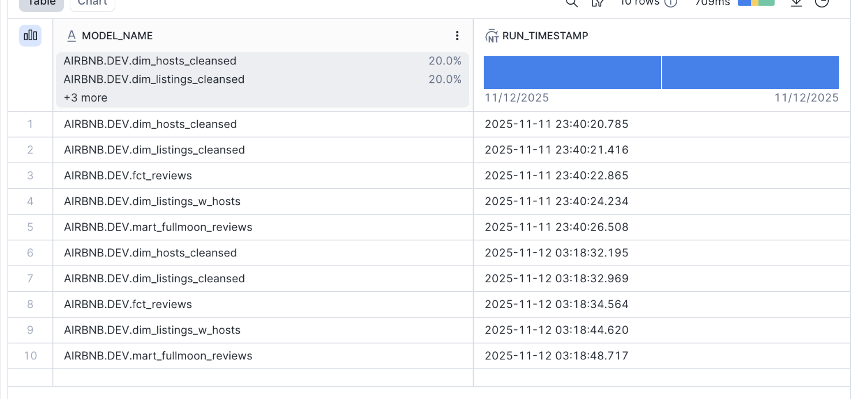
Final view of our data warehouse in the end. Includes audit_log which provides logs of model runs (made in dbt)

Slide 8
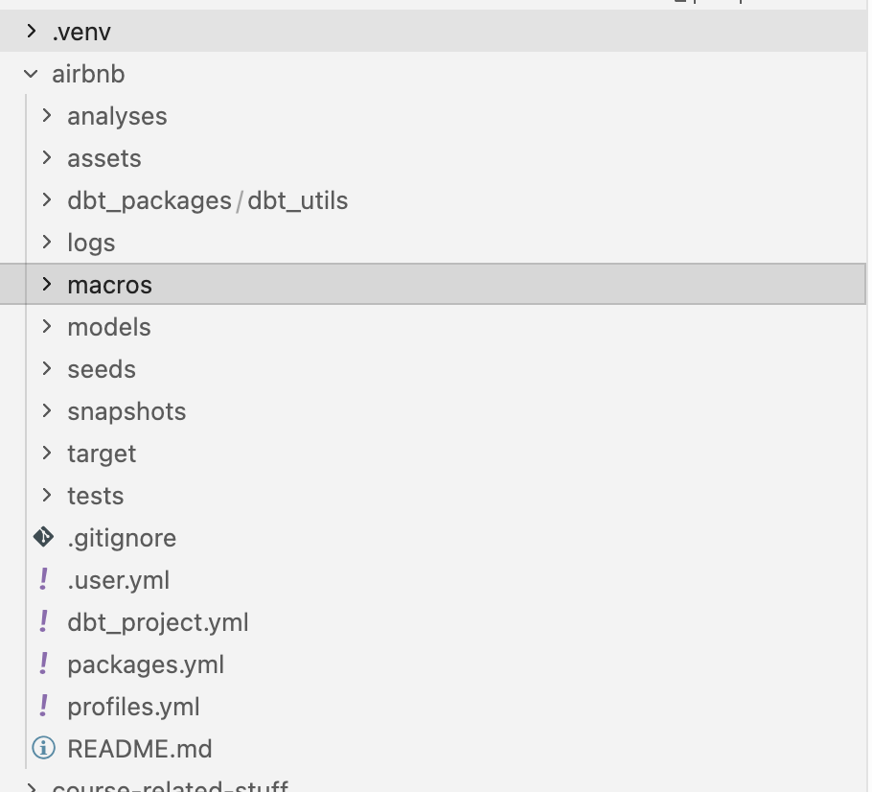
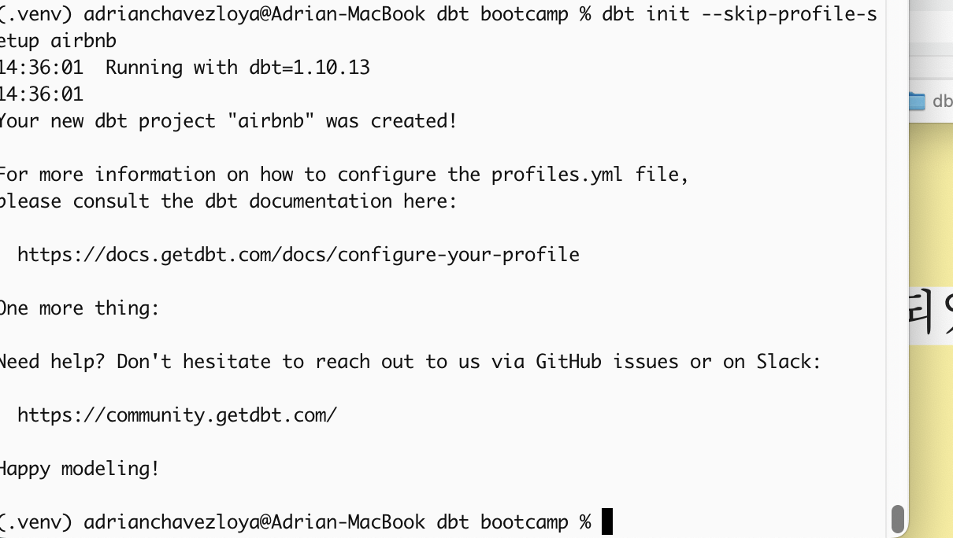
We initialized and isolated dependencies with a virtual environment. On the left is the final view of the dbt project.

Slide 9
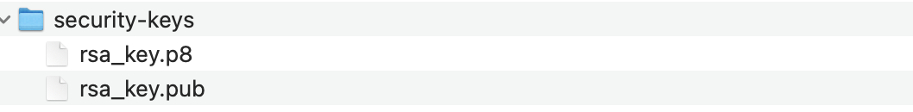
We also generated a public/private key for secure access to Snowflake (user/password method is going to be discontinued in Snowflake). You saw the public key earlier.

Slide 10
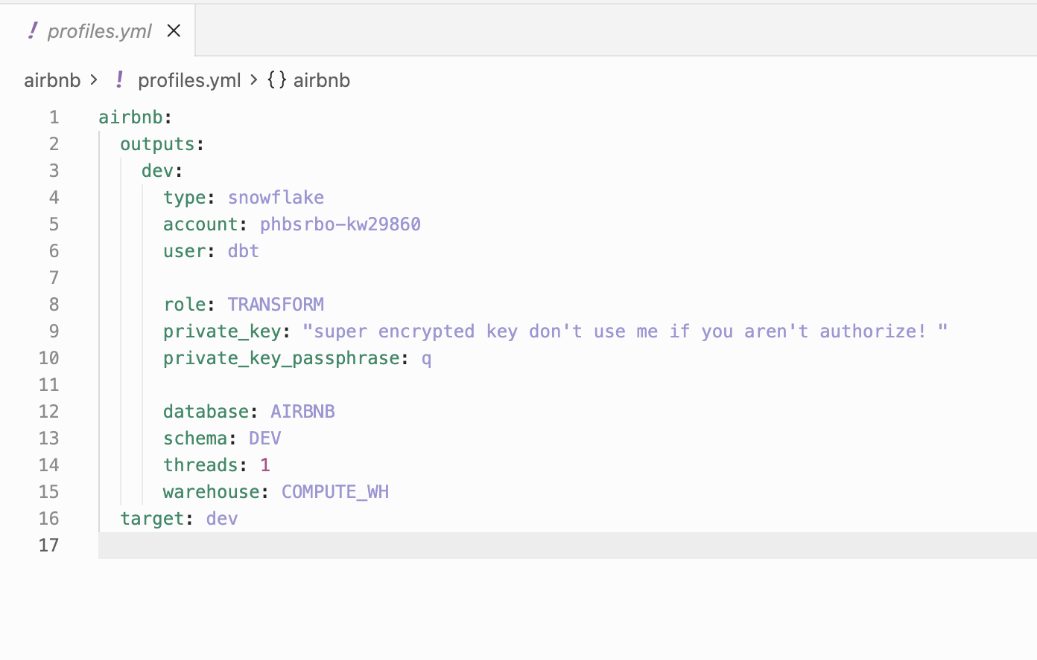
We have our profiles.yml connecting dbt to our data warehouse

Slide 11
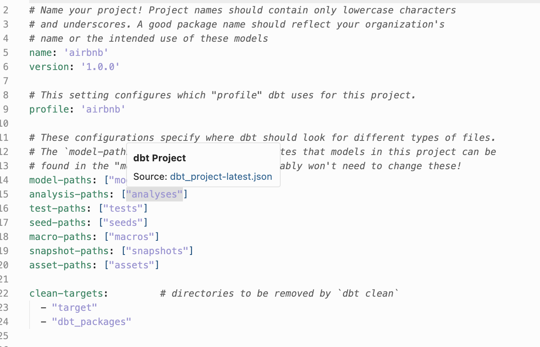
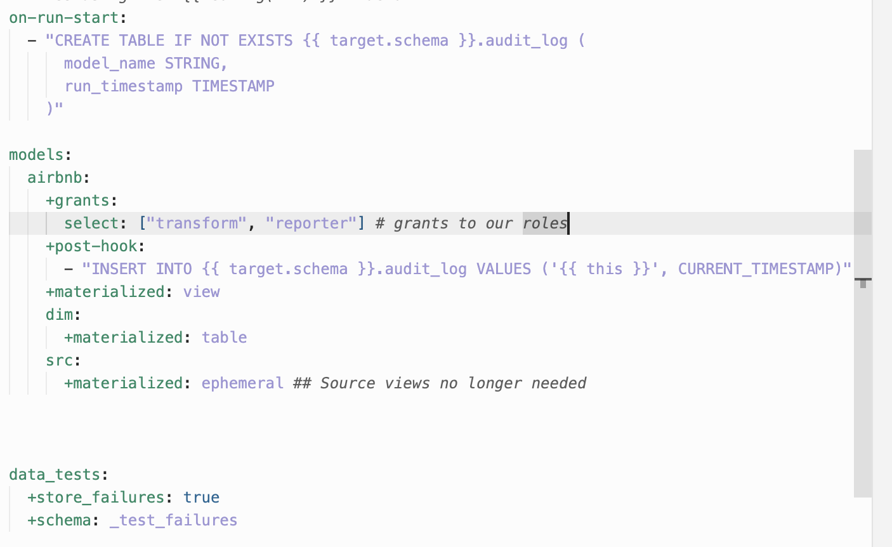
dbt_project.yml defines our targets and configurations for our folders. In this, we practiced usings grants for roles, hooks, and set our types of default materialization settings we wanted for our data layers.

Slide 12
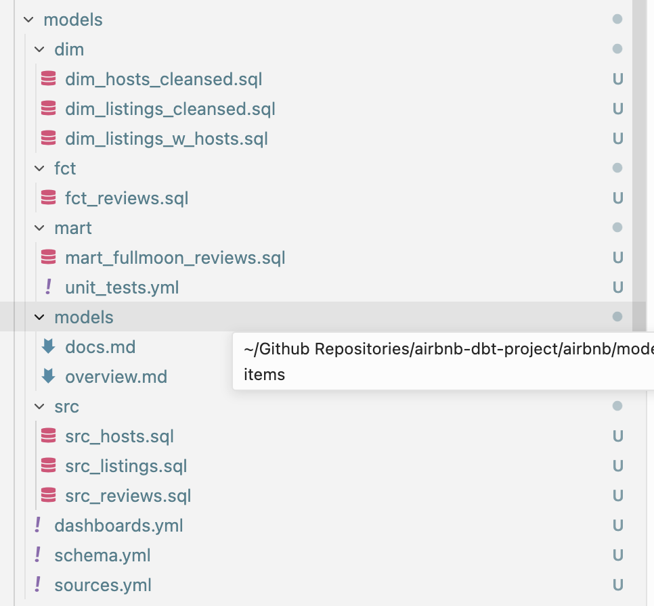
Models folder has all our models. Look at them all in detail in the github repository

Slide 13
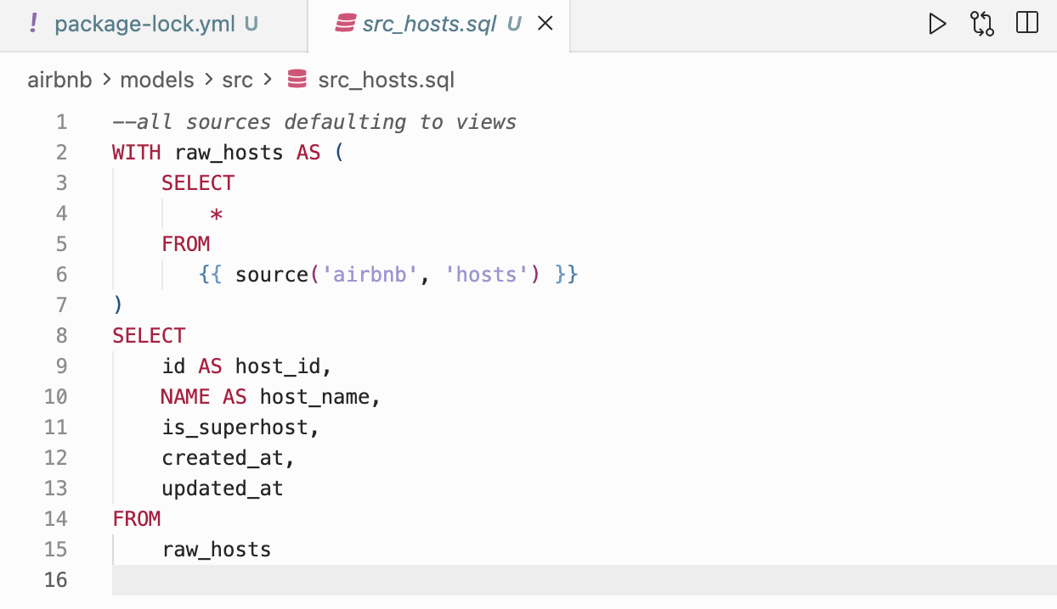
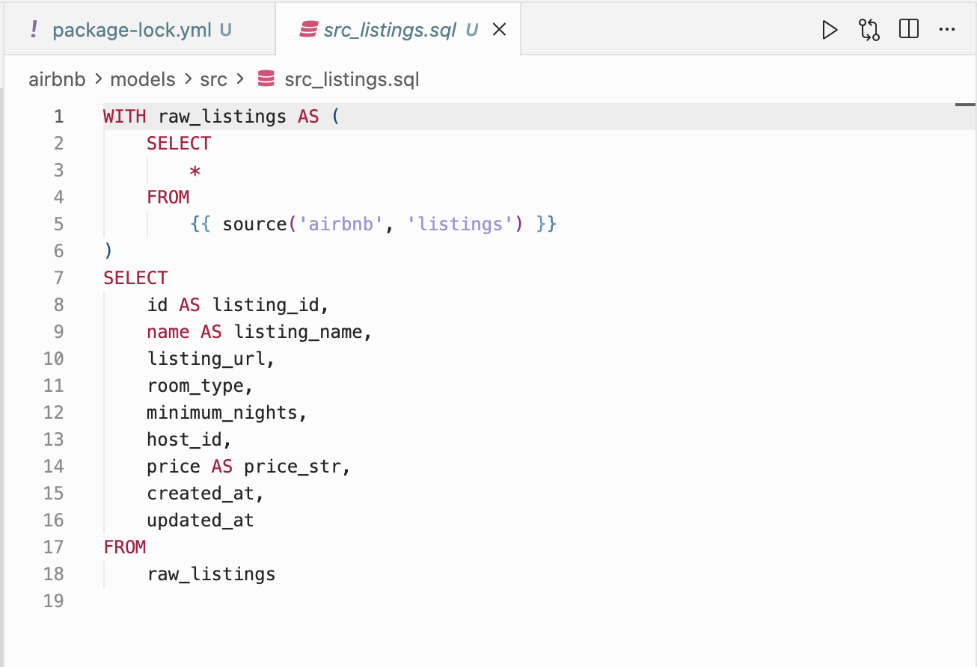
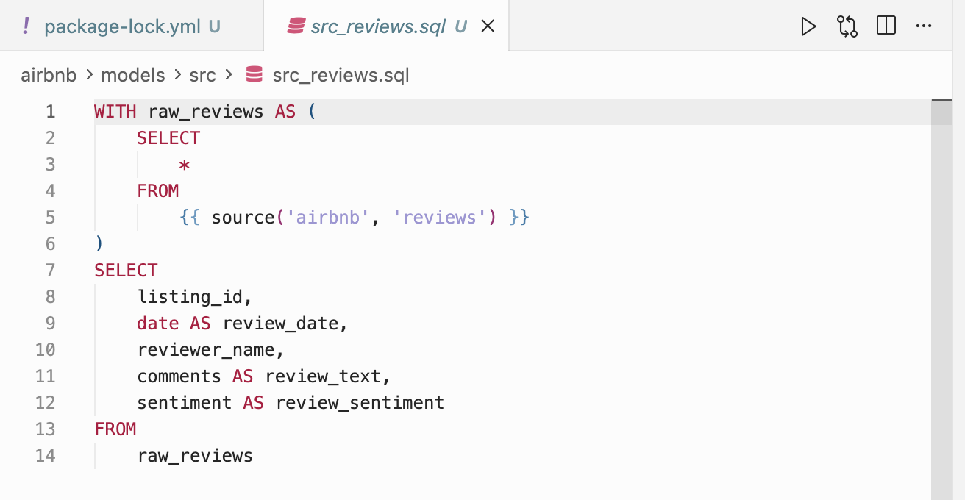
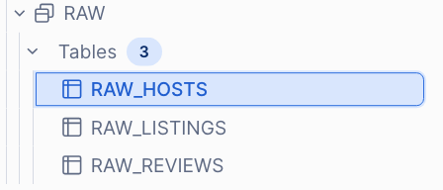
Our source layer (staging) tables! I just adjusted some columns from our raw layer.
Raw tables

Slide 14
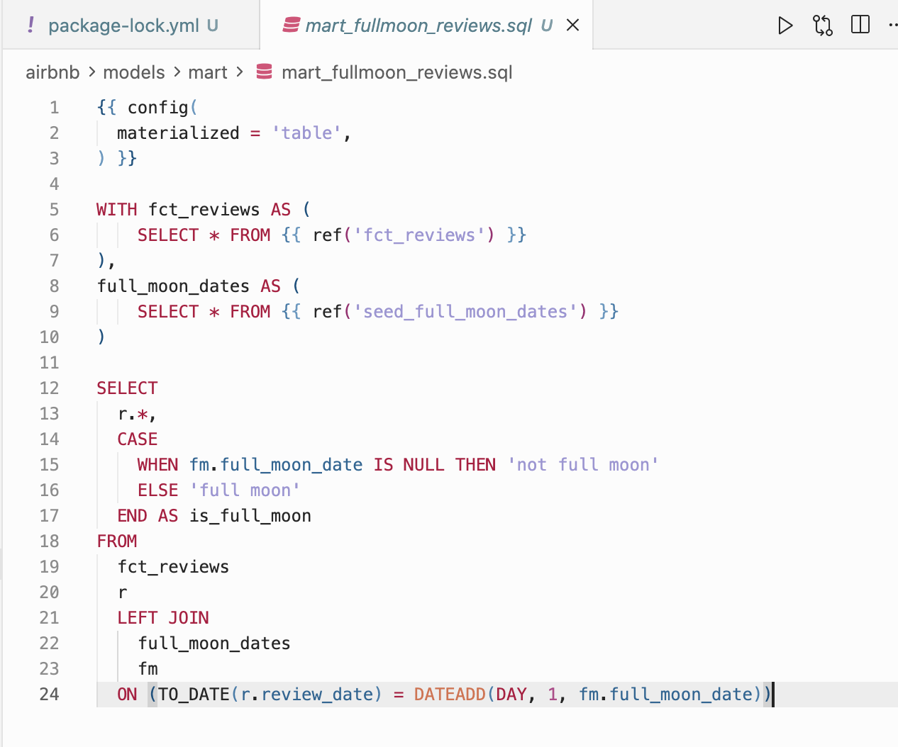
This is a mart table we created for fun to view reviews to see if people are more moody and perhaps give worse reviews.

Slide 15
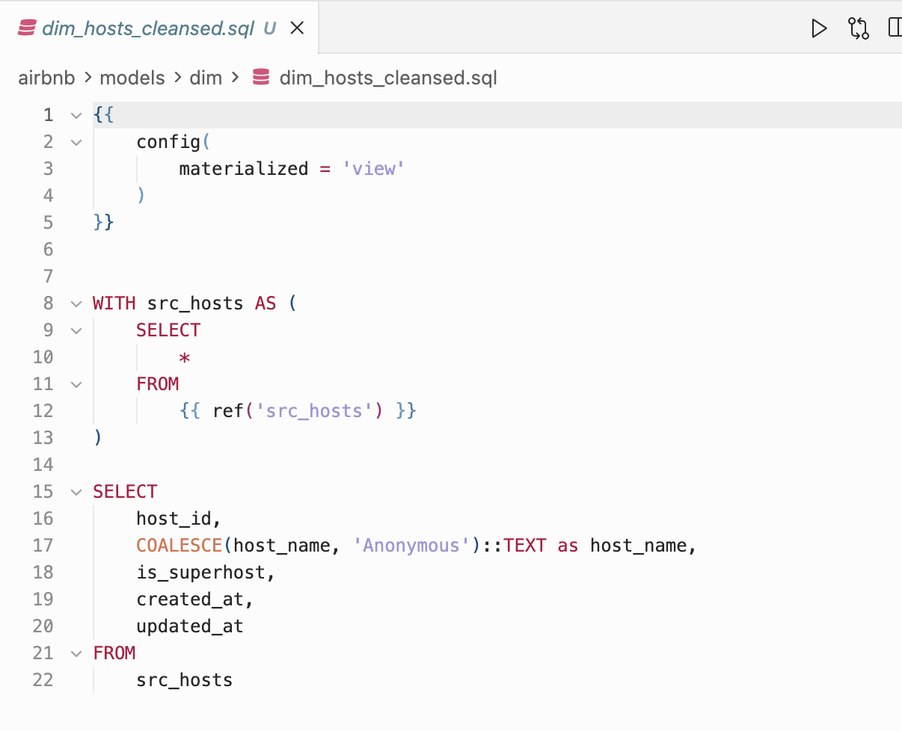
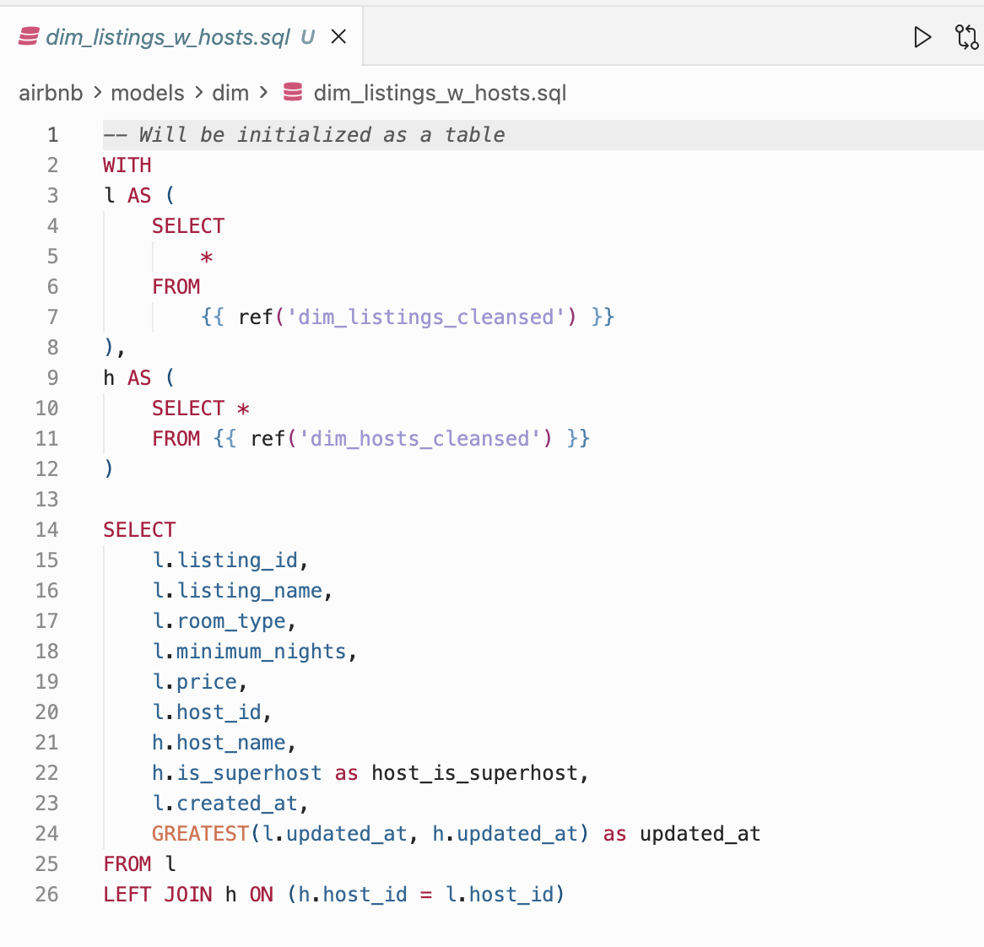
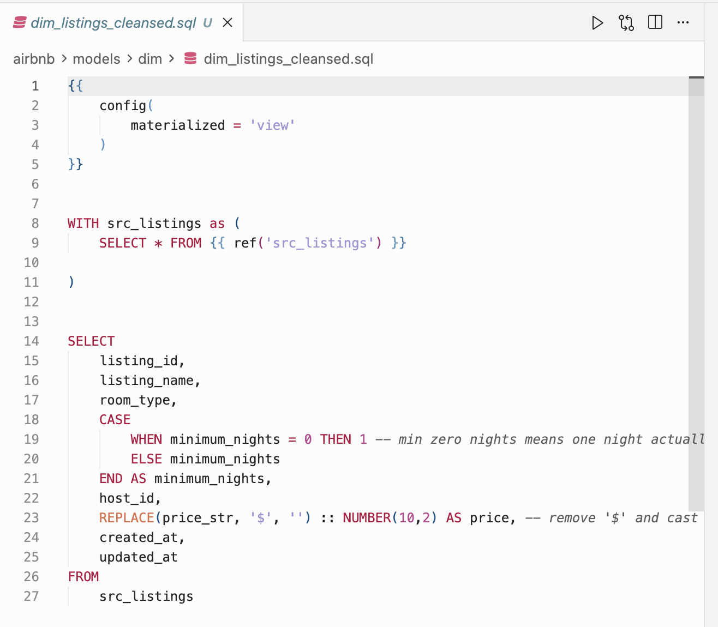
Dimension tables for listings and hosts are made and combined for better analysis. We mainly use dim_listings_w_hosts for our dashboard later.

Slide 16
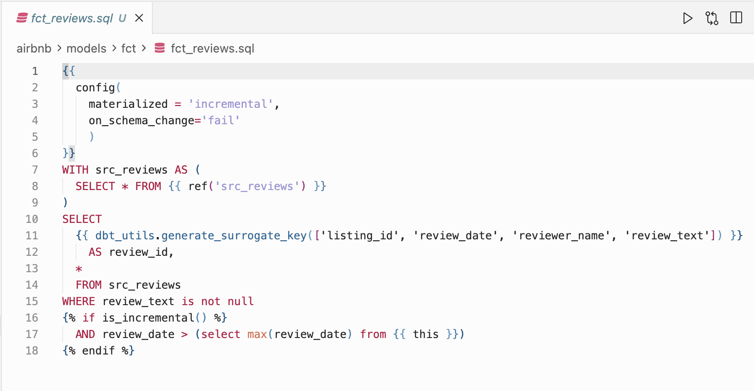
We created a fact table for reviews but doesn’t include the typical metrics a typical fact table would

Slide 17
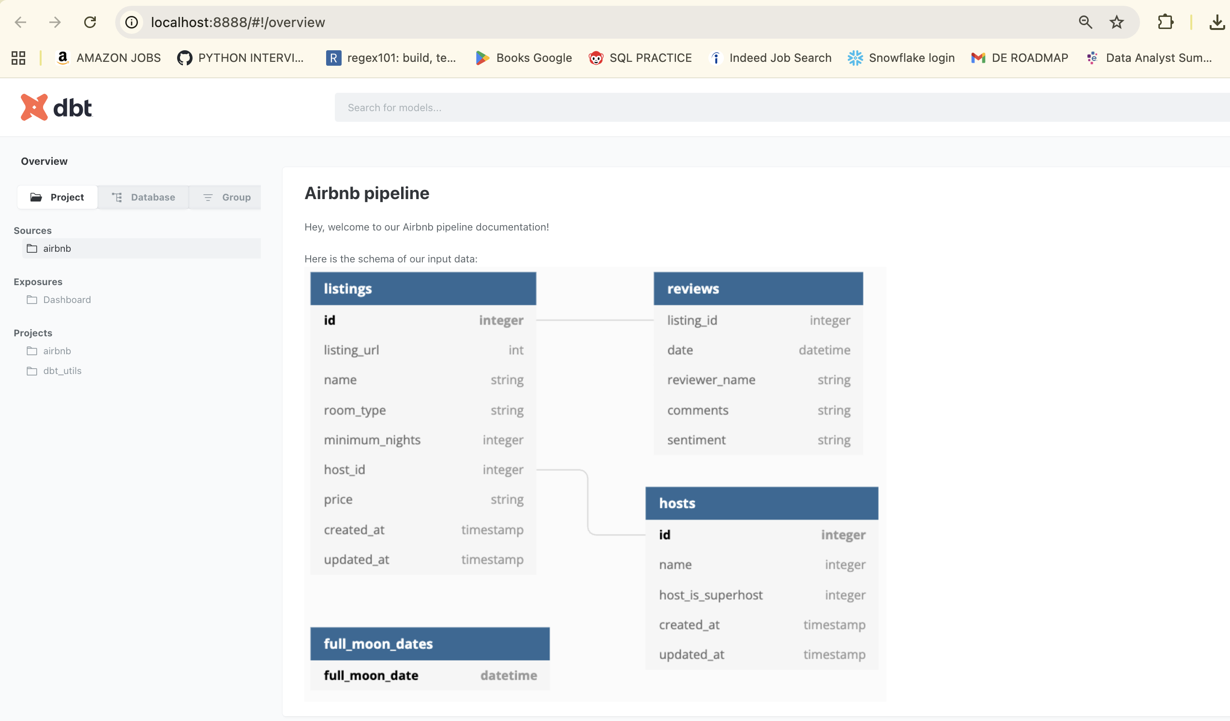
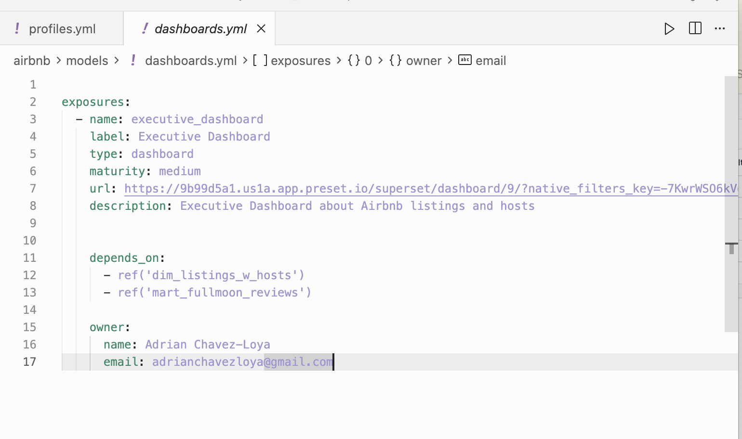
We created easy markdown files to create our UI menu which includes our input data and some text.

Slide 18
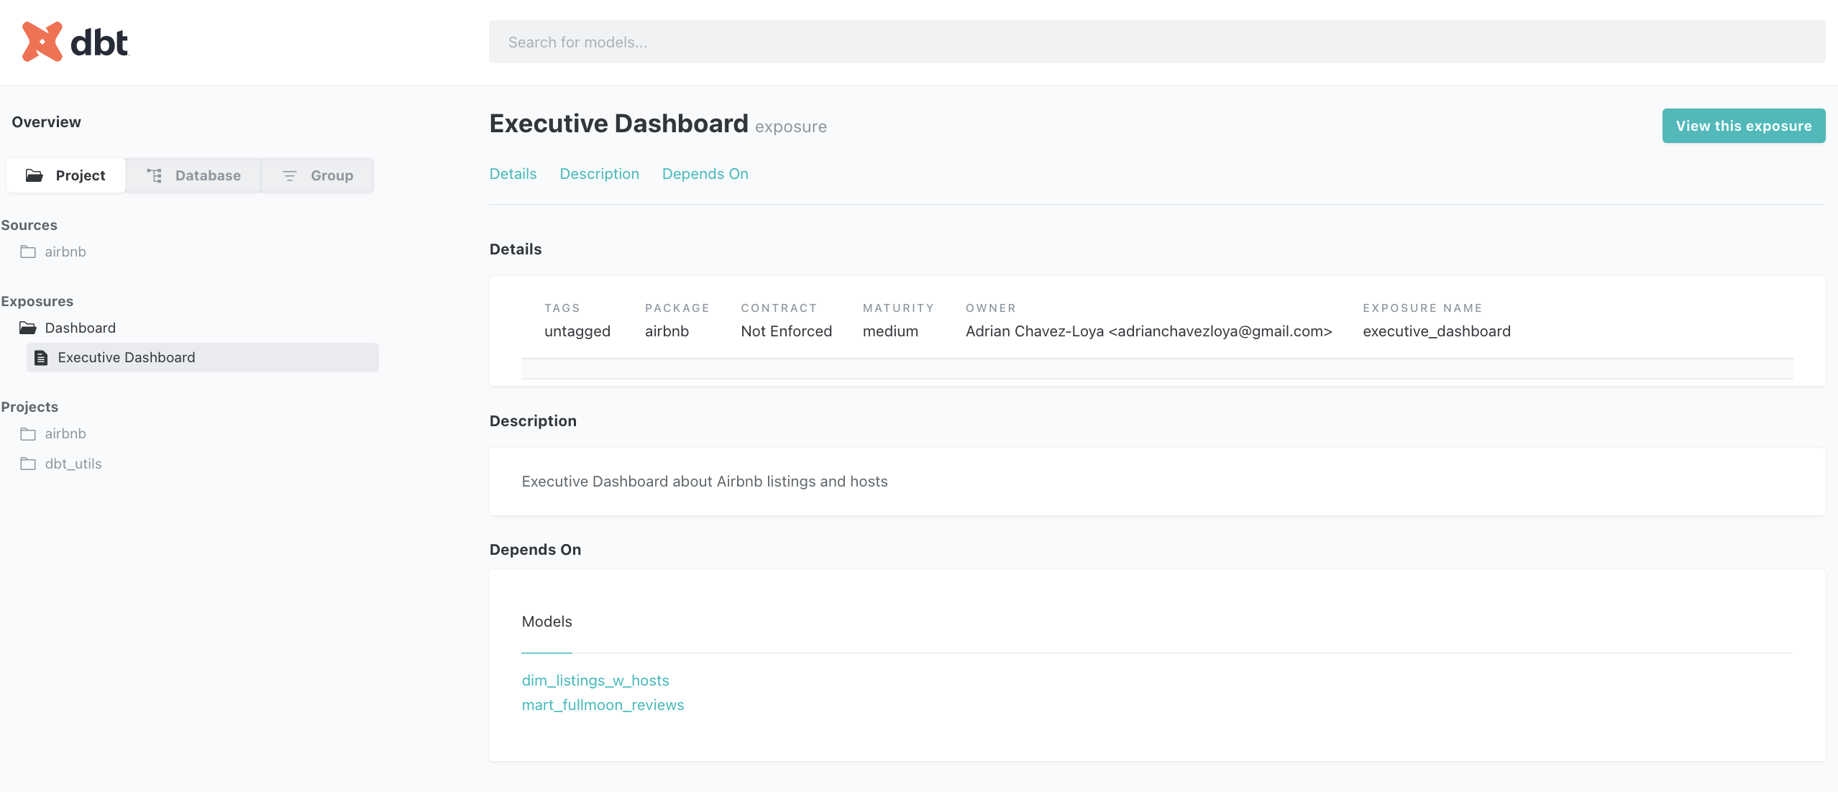
We also have a direct link to our simple dashboard for this project

Slide 19
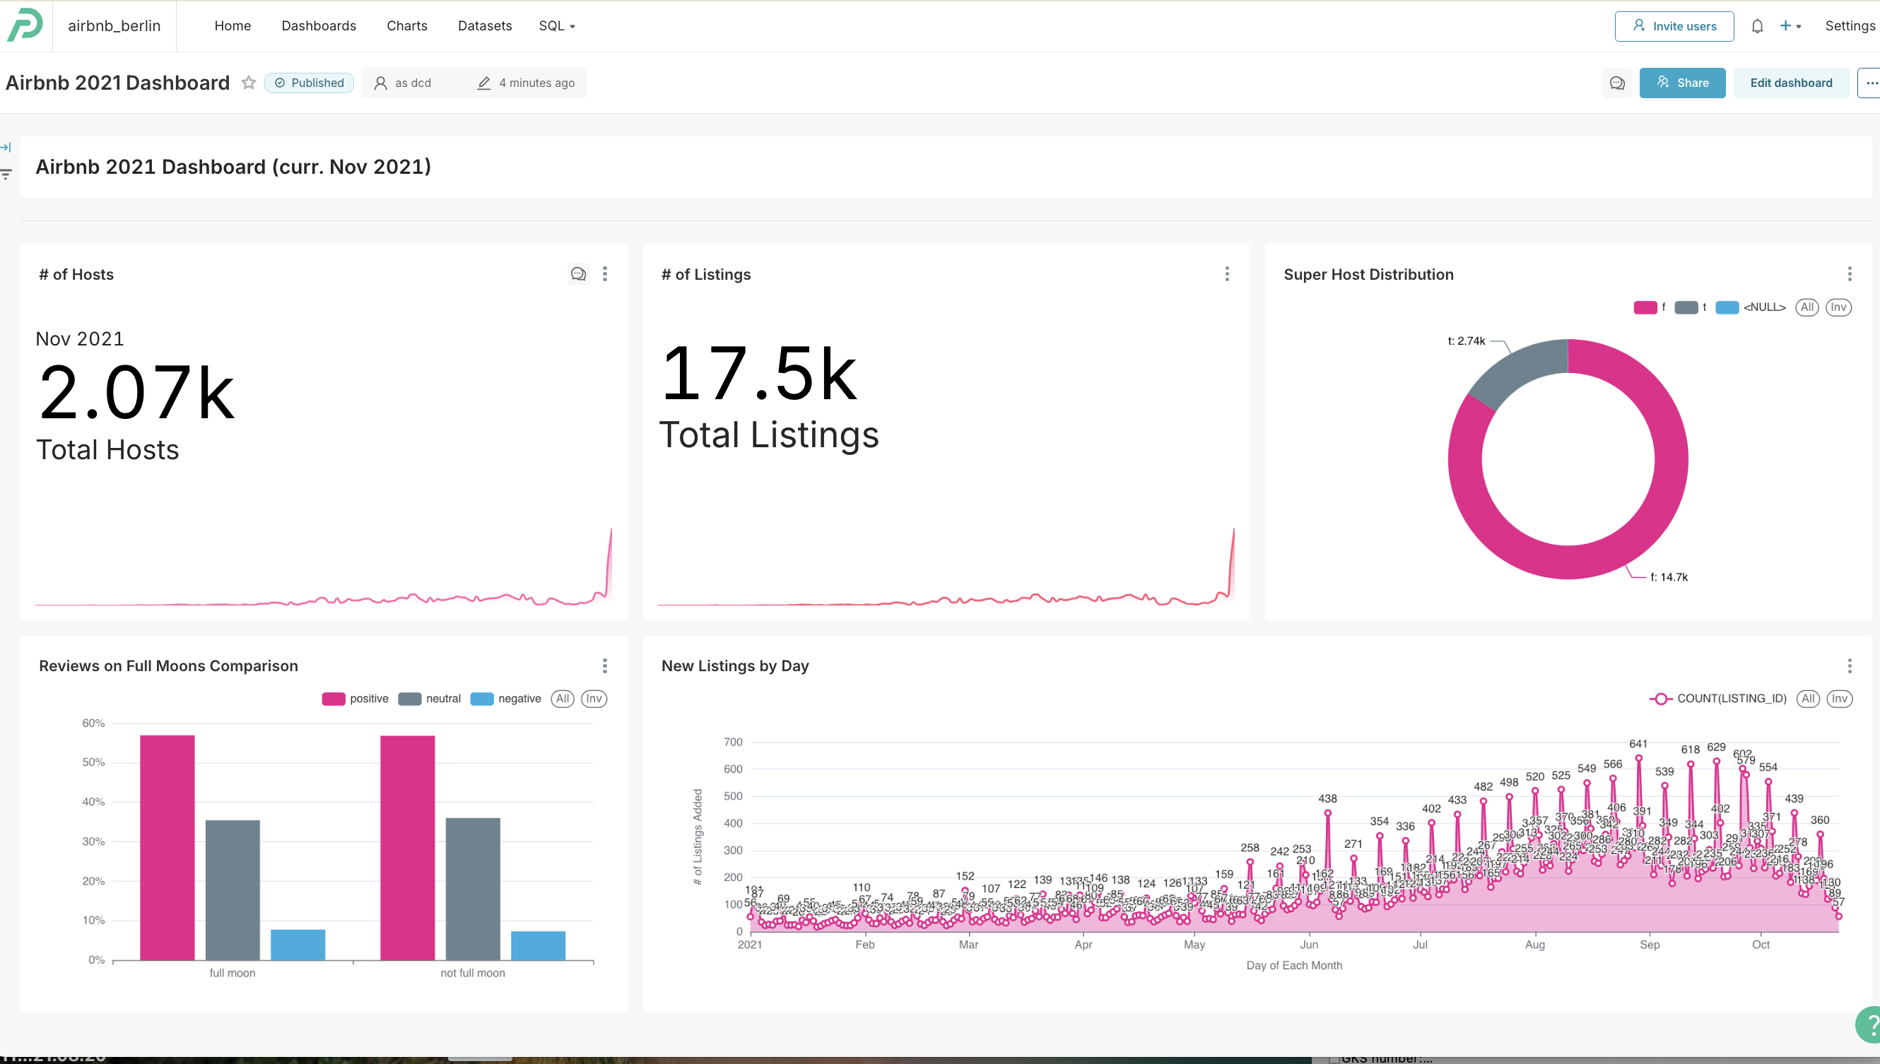
Our dashboard we connected to Snowflake and created with Preset (Side Note: turns our people are unaffected by full moons when reviewing)

Slide 20
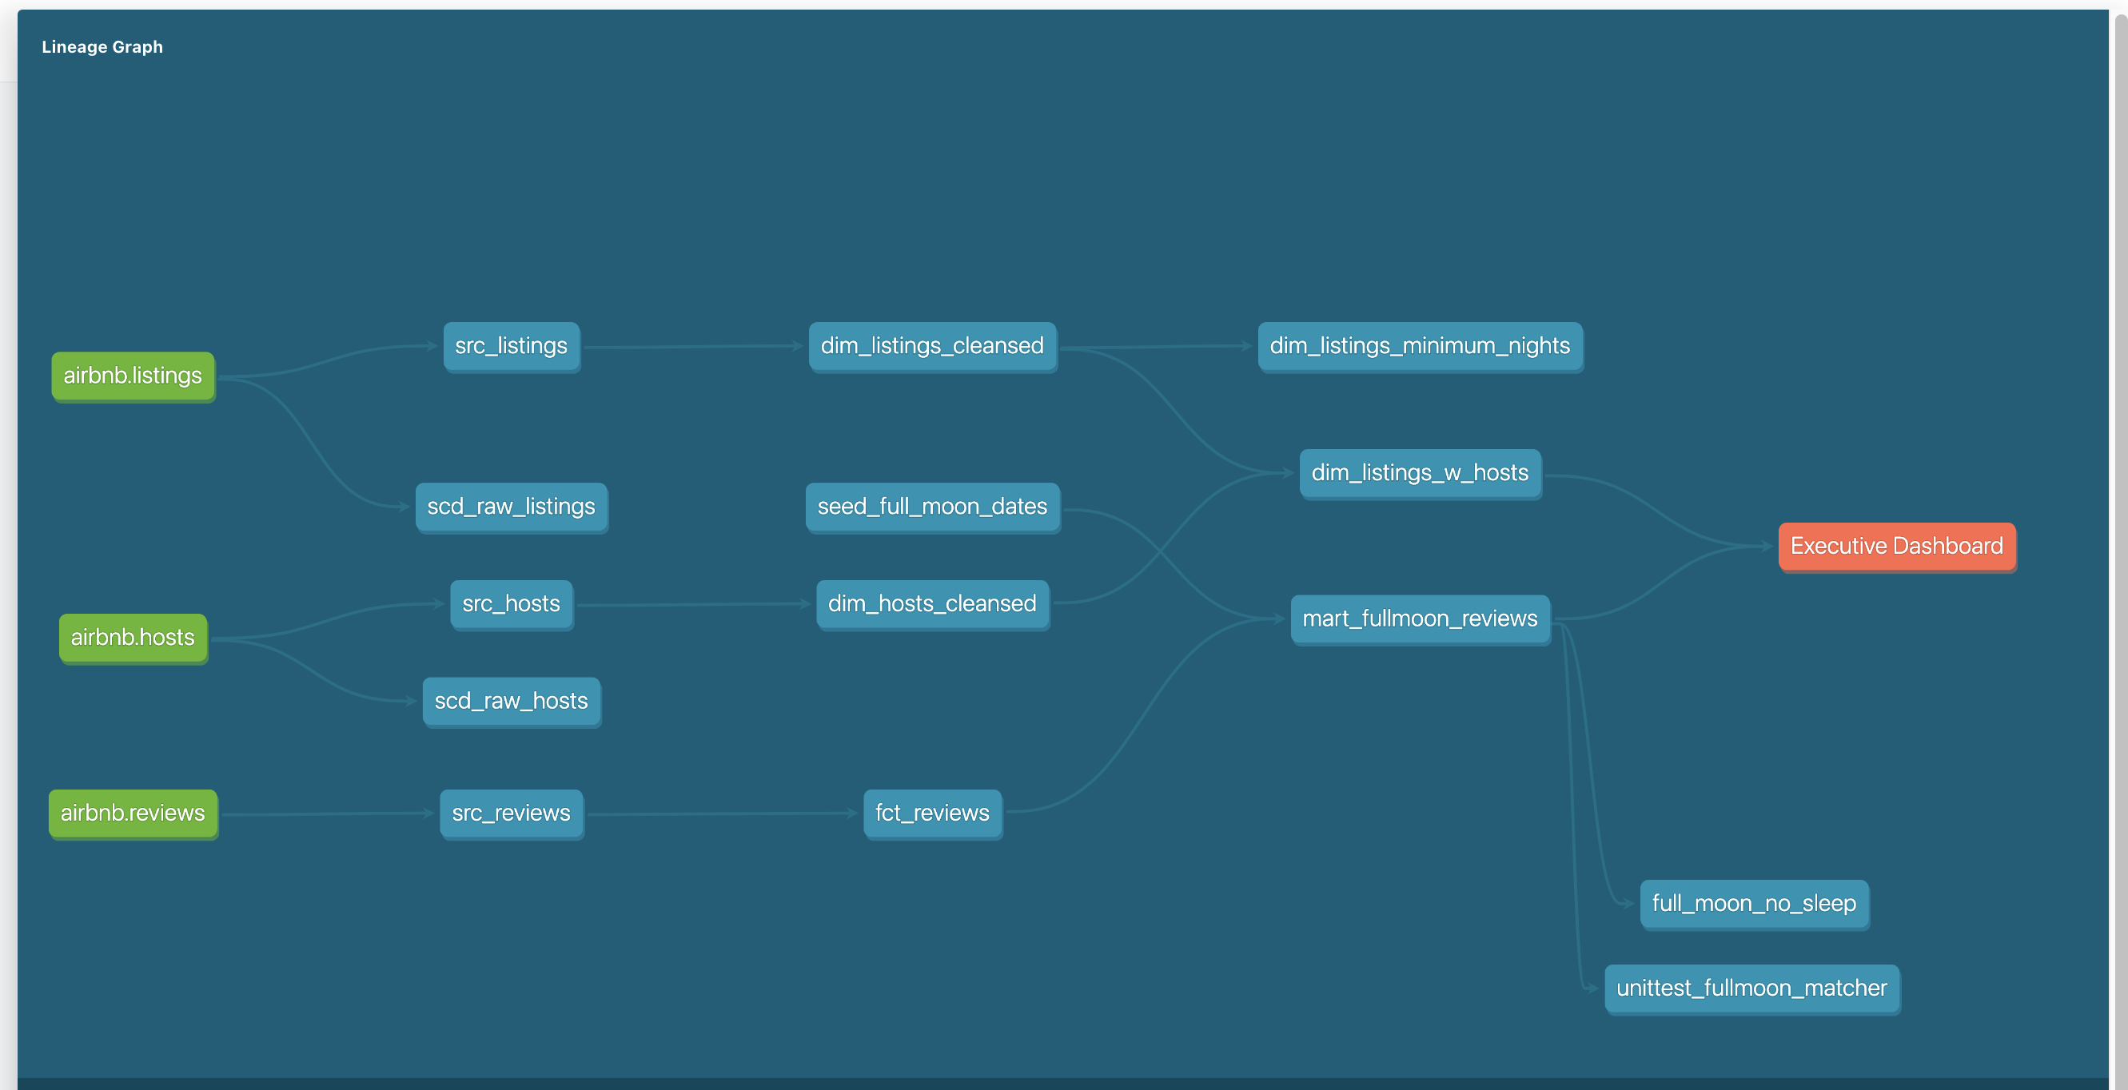
Here is our lineage graph made with dbt

Slide 21
We did a number of other exercises which can be found in the repository. This includes:
- Implementing Jinja2 macros
- Created snapshots
Made sample validation tests
Experimented with dagster orchestration

Slide 22
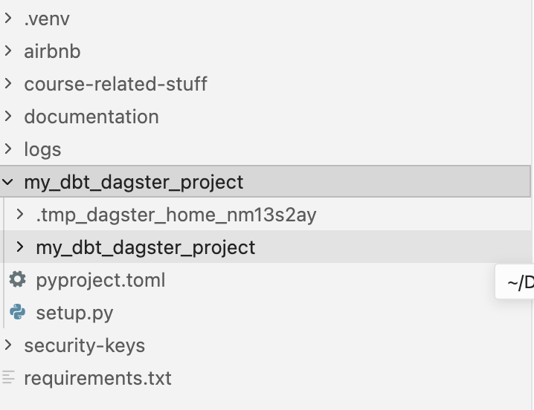
I will show you some screenshots of my initialized UI interface for dagster which I used to also play around with its scheduler and see how it can be used for orchestration much like Airflow. We were able to scaffold dagster into our dbt project.

Slide 23
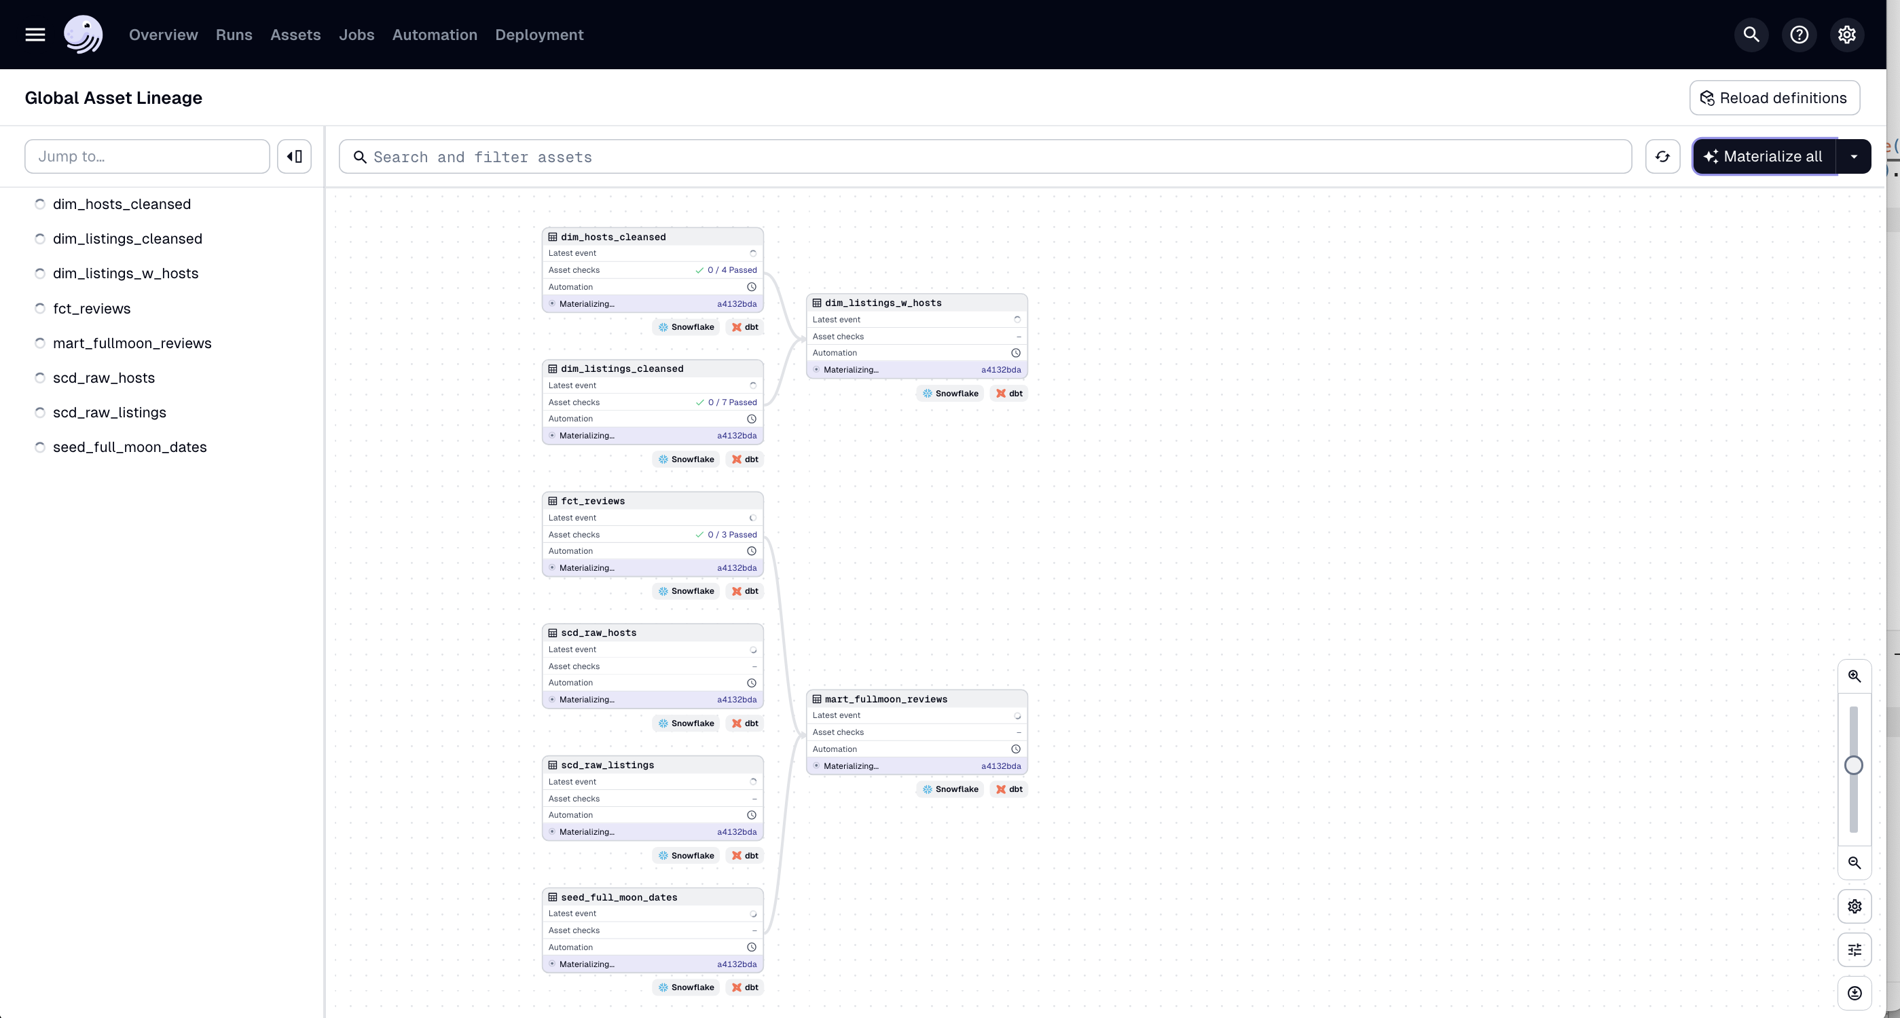
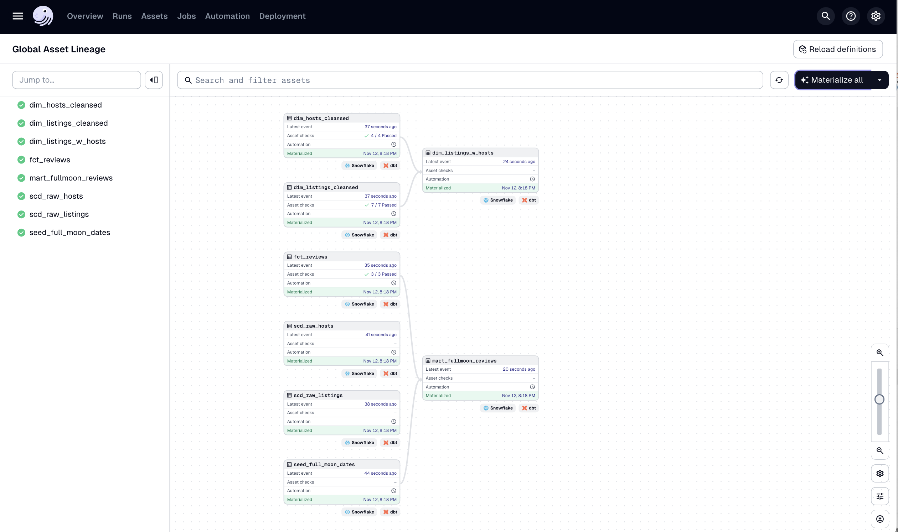
Here is asset lineage within Dagster

Slide 24
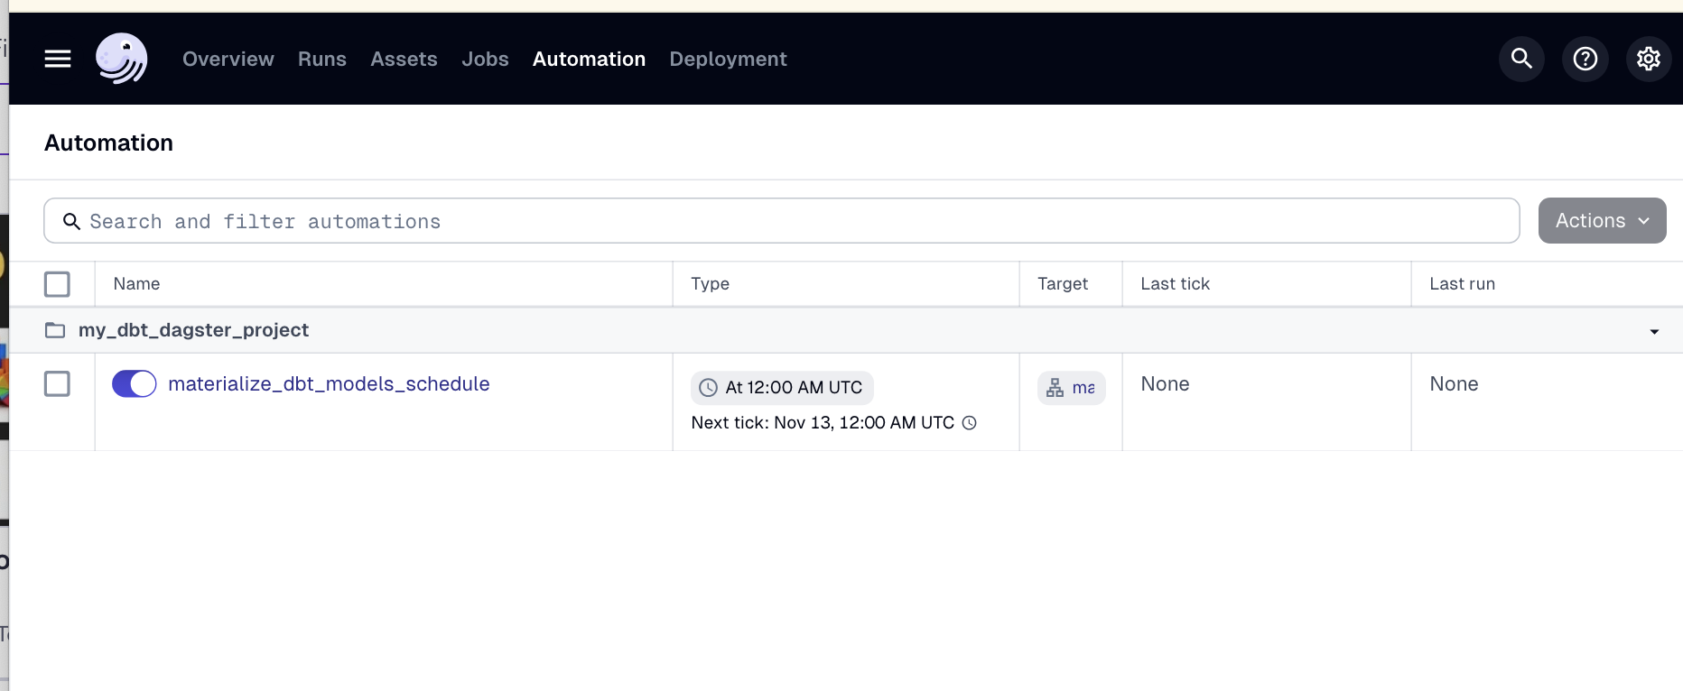
If we wanted to continually run our dbt models on schedule we could with Dagster!

Slide 25
Ultimately through this project, we were able to learn some of the following:
How to implement data models and perform ELT for Snowflake using dbt
How to tune and tweak different settings to implement different table/view types at different stages
Learned about Jira macros, seeds, snapshots, hooks exposures, and so much more!
Practiced using a creating a data warehouse that was usable for analysis

